Slide 1
Logging Kubernetes with Fluentd & Papertrail
Alex Ouzounis, Platform Architecture

Slide 2
Resources
Event Graphics & Flyers
https://drive.google.com/open?id=1-1qxxBsusB1pByUklbbt3k_Do6wSYLPF
Announcement Article
https://www.zive.cz/clanky/pozvanka-na-konferenci-innovate-summit-innovation-goes-social-at-solarwinds-innovate-summit-2017/sc-3-a-190647/default.aspx
Event Planning & Tasks
https://cp.solarwinds.com/display/Eng/SolarWinds+Innovate+Summit+2017
Event Site & Schedule
https://innovate.solarwinds.io

Slide 3
The SolarWinds and SolarWinds Cloud trademarks are the exclusive property of SolarWinds Worldwide, LLC and its affiliates and may be registered or pending registration with the U.S. Patent and Trademark Office and in other countries. All other SolarWinds and SolarWinds Cloud trademarks, service marks, and logos may be common law marks or are registered or pending registration. All other trademarks mentioned herein are used for identification purposes only and are trademarks (and may be registered trademarks) of their respective companies.

Slide 4
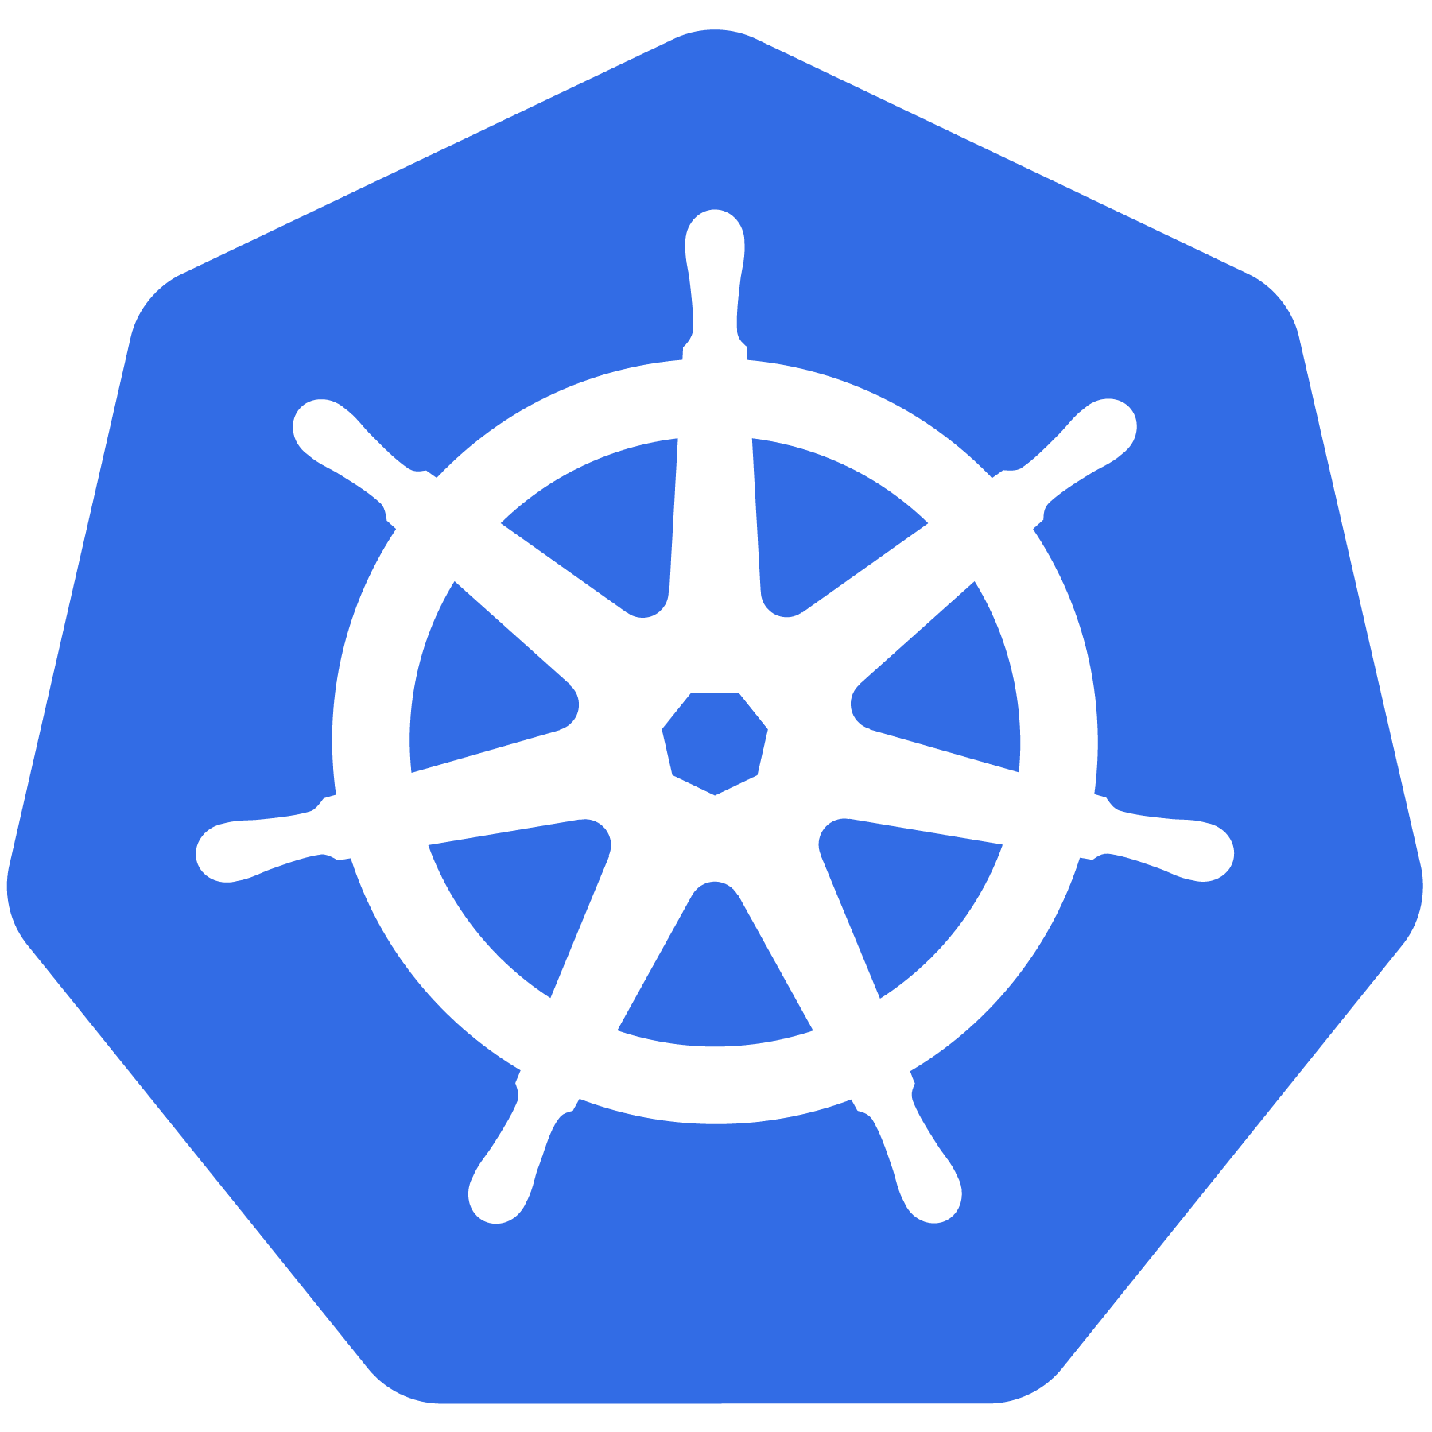
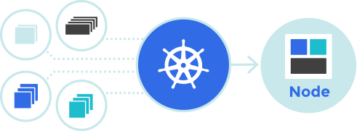
Kubernetes
Kubernetes® is an open source platform for automating deployment, management and scaling containerised applications
Image from https://kubernetes.io
Image from https://github.com/cncf/artwork

Slide 5
PaperTrail
Aggregate logs from thousands of sources
Slice and dice logs depending on source
Tail & Search
React & Analyse

Slide 6
Fluentd
Data Collector that allows us to unify data collections and consumption
Structures data as JSON
Collects, filters, buffers and outputs logs across multiple sources and destinations
Read logs for any file source
Parses logs in pipelines
Read logs from multiple sources with any format into JSON
Apply as many filters as you want
Tag
Output to multiple destinations
input
parse
filter
buffer
output
formatter

Slide 7
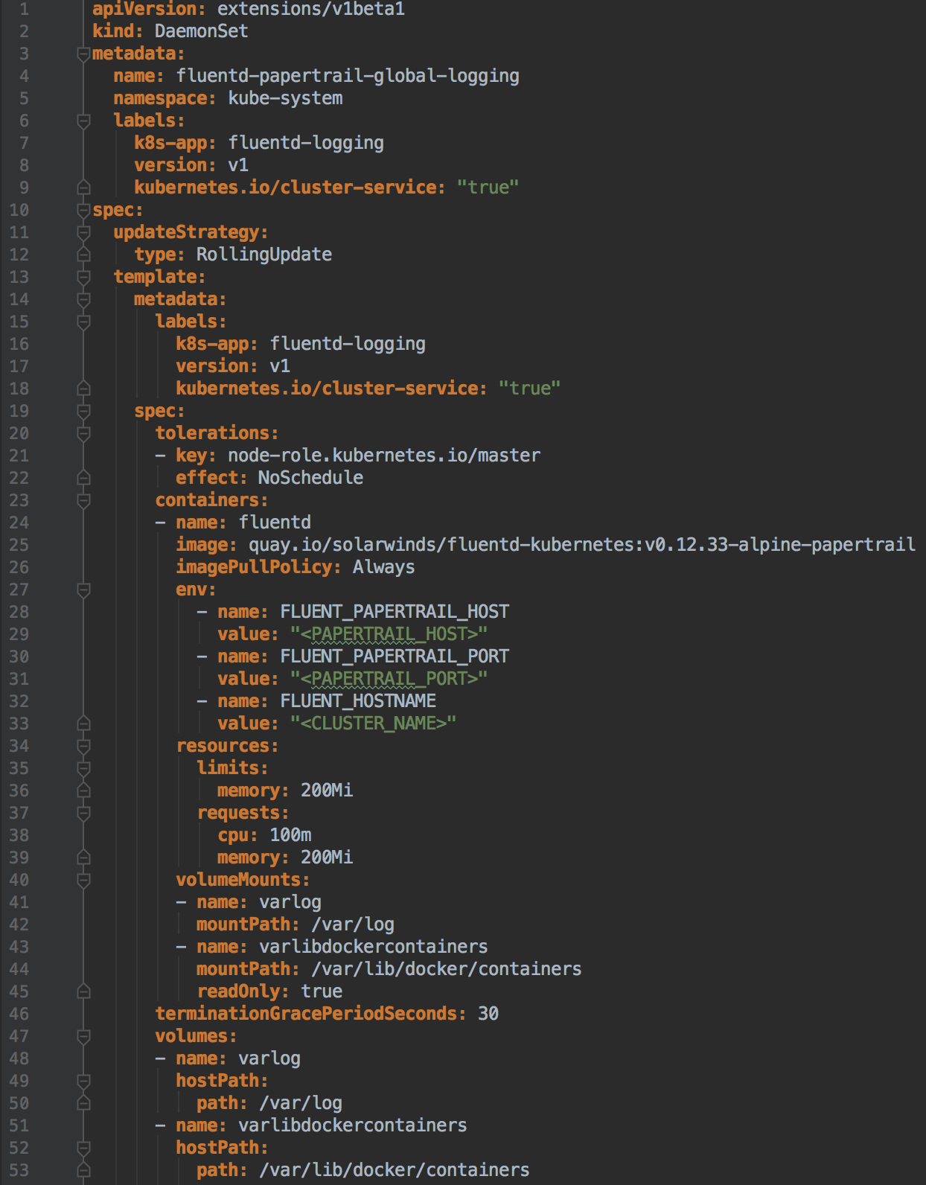
Kubernetes & Fluentd & Papertrail
Fluentd ® plugin for Papertrail ® https://github.com/solarwinds/fluent-plugin-papertrail
Docker ® image with Fluentd ® and the Papertrail ® plugin preinstalled docker pull quay.io/solarwinds/fluentd-kubernetes
Kubernetes ® Daemonset that deploys above container in a pod in all nodes in the cluster https://github.com/fluent/fluentd-kubernetes-daemonset/pull/52
Logs from all workloads running on Kubernetes ® are now streamed to Papertrail ® while preservice the namespace, pod name and container name

Slide 8
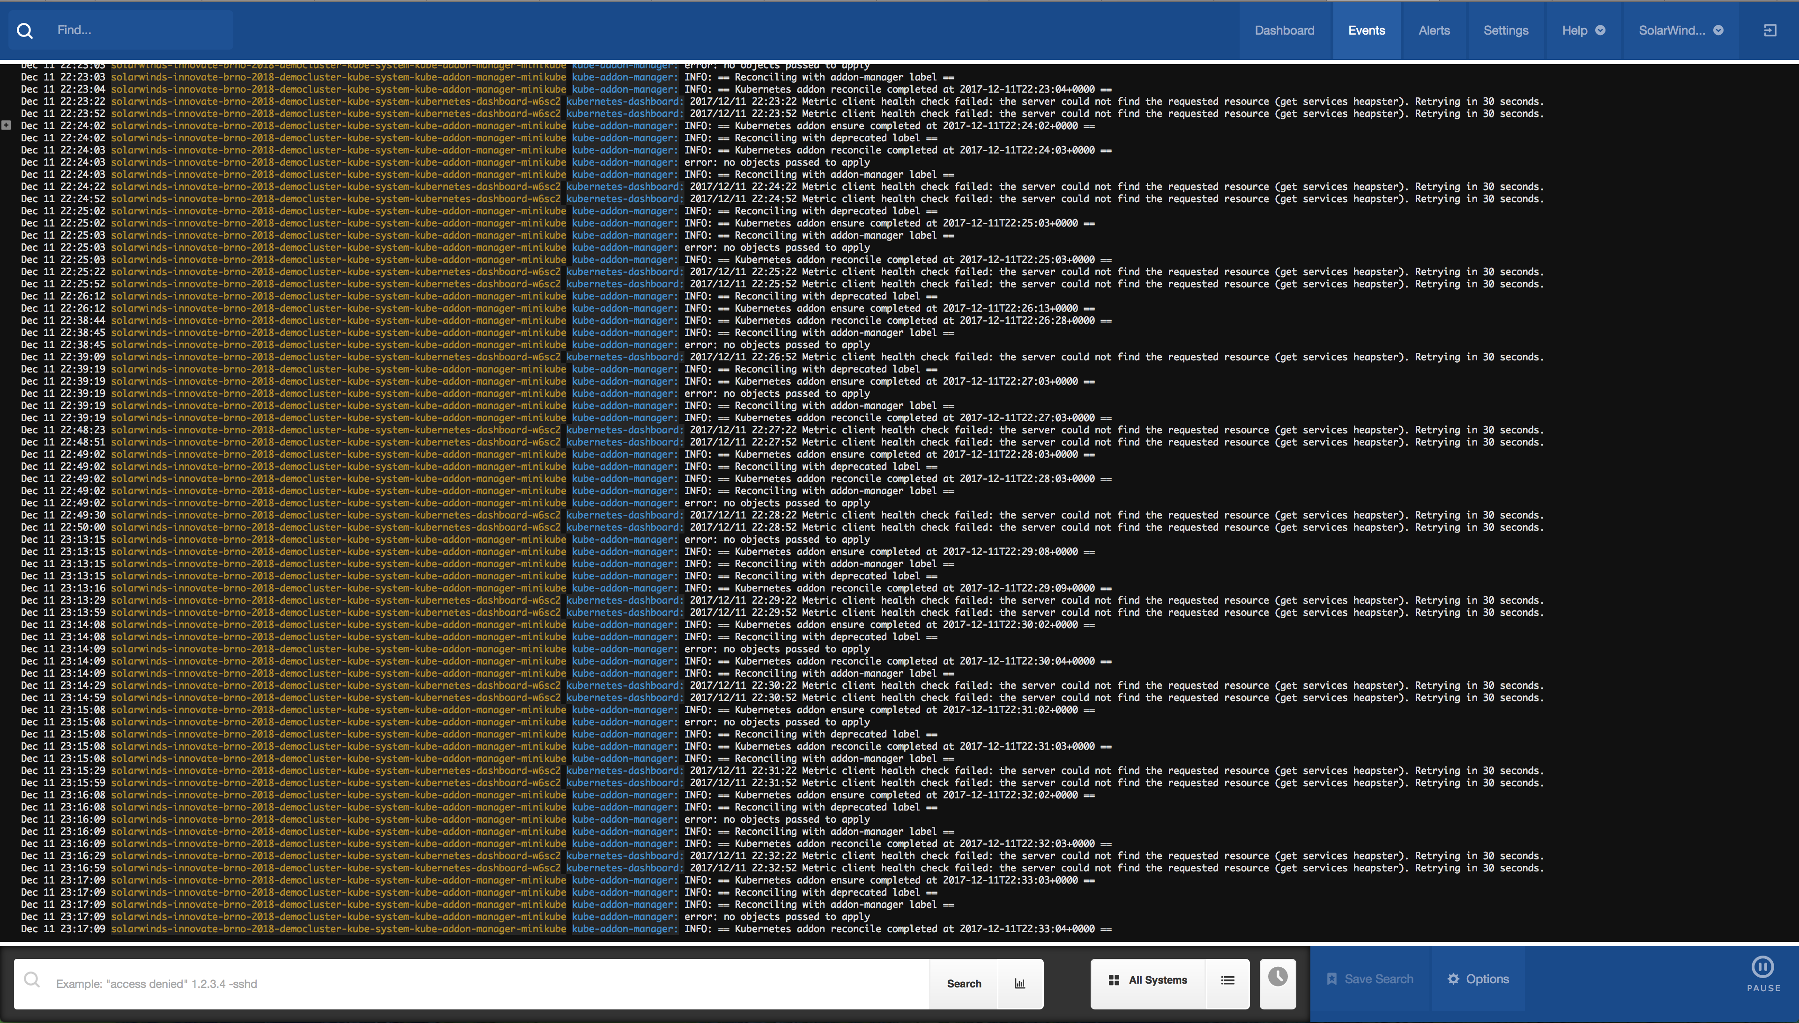
Kubernetes & Fluentd & Papertrail

Slide 9
Kubernetes & Fluentd & Papertrail
Demo

Slide 10
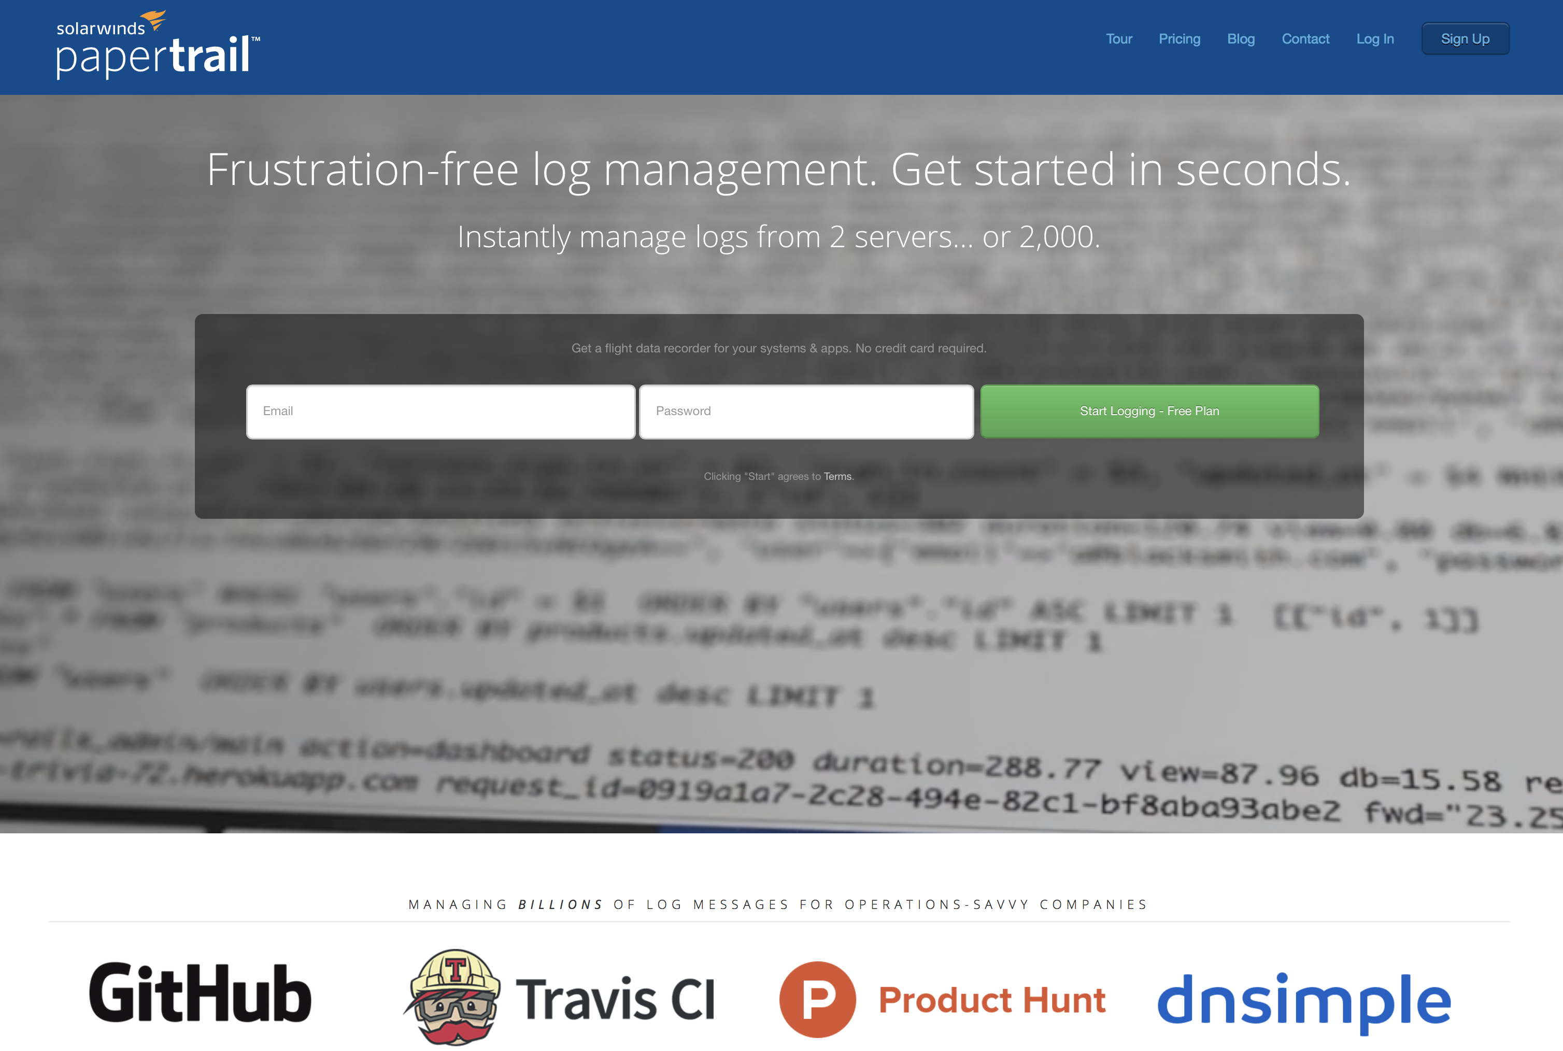
Kubernetes & Fluentd & Papertrail
Questions ?
https://papertrailapp.com

